Slide 1

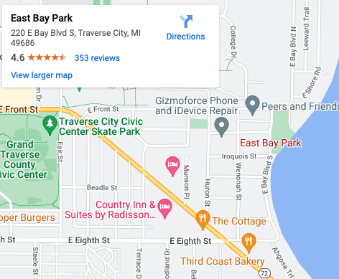
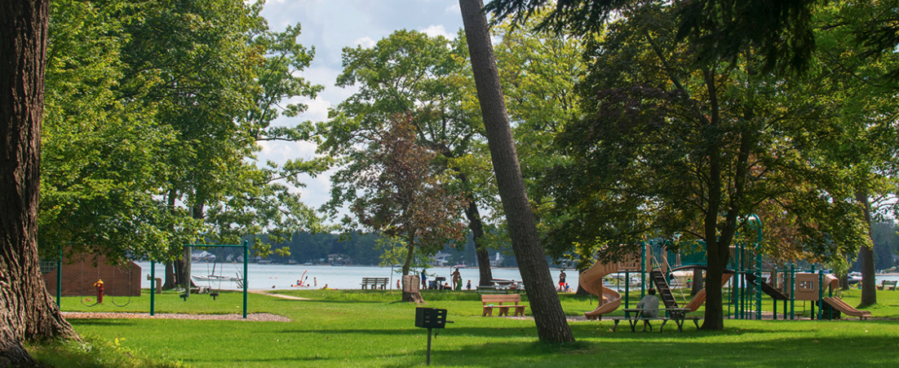
Intern Event
Games, Food & Networking on the Beach
The Traverse City Human Resources Association is hosting Intern Networking events this summer as an opportunity for local interns to meet, have fun and do some casual networking.
Who: Students who are participating in any level or type of internship in the Traverse City area.
Local area companies and organizations who would like to meet some of the great talent employed this summer around the area are encouraged & welcomed to attend.
Why: An opportunity for students to meet peers around the area along with interacting with some of the local businesses. Additionally, these events are designed to have fun!
When: Wednesday, August 2nd 7pm to 9pm
Where: East Bay Park (220 E Bay Blvd S)
What: Food, soft drinks and games!
RSVP: At our website www.tahrarc.org or scan the QR code for the link.

